Slide 1
INDIAN KNOWLEDGE SYSTEM
Traditional Knowledge System
Indian Ancient Education System

Slide 2
Traditional Knowledge System
Traditional knowledge systems encompass the collective wisdom and practices developed over generations within various cultures. These systems often include understanding of the environment, medicinal practices, rituals, and social norms. They offer insights into sustainable living and cultural heritage, providing an ultimate connection to ancestral ways of life and a profound understanding of the world.

Slide 3
Indian Traditional Knowledge System
In the Indian context, traditional knowledge systems are diverse and deeply rooted in the country’s rich cultural and historical heritage. These systems encompass various fields such as agriculture, medicine, astronomy, and spirituality, often passed down through generations within communities.

Slide 4
Features
Ayurveda: One of the oldest systems of medicine, Ayurveda focuses on balancing bodily energies (doshas) through diet, herbs, and lifestyle practices to maintain health and prevent illness.
Yoga and Meditation: These practices, originating in ancient India, emphasize physical postures, breathing techniques, and mental discipline to achieve physical health, mental clarity, and spiritual growth.

Slide 5
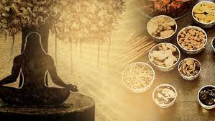
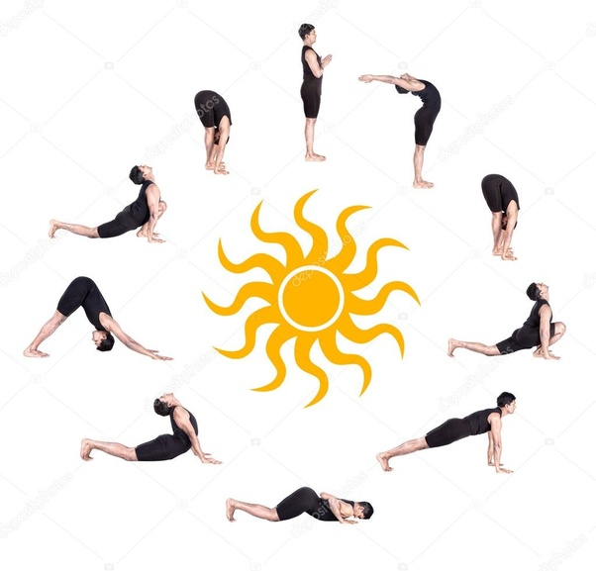
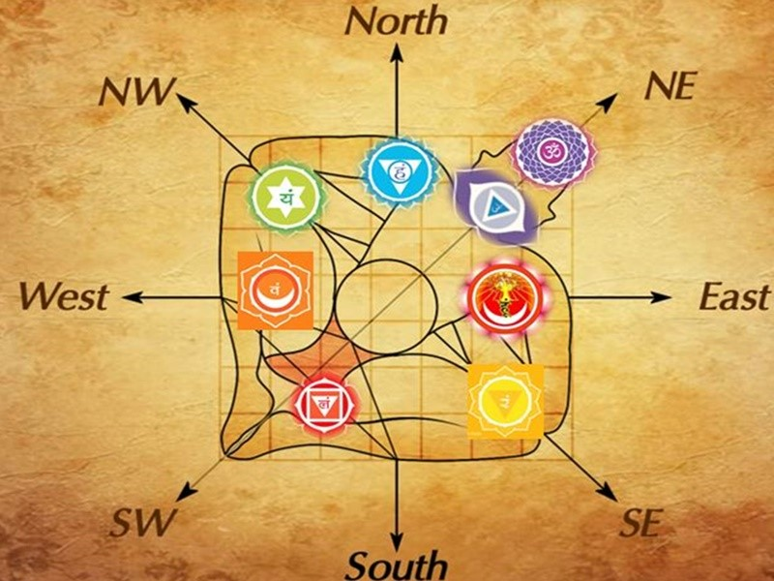
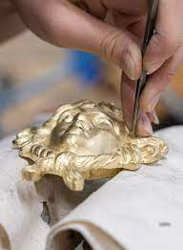

Slide 6
Features
Vastu Shastra: This traditional architectural science involves designing buildings and spaces according to principles believed to align with cosmic and earthly energies to ensure harmony and prosperity.
Indigenous Agricultural Practices: Traditional farming methods, including crop rotation, organic farming, and rainwater harvesting, reflect deep ecological knowledge and sustainable practices tailored to local environments.

Slide 7
Features
Oral Traditions and Folklore: Stories, myths, and oral histories preserved in diverse languages and dialects form an integral part of Indian cultural heritage, providing insights into societal values, beliefs, and history.
Traditional Craftsmanship: Techniques in weaving, pottery, and metalwork are passed down through generations, reflecting regional styles and skills that contribute to India's rich artisanal heritage.

Slide 8
ANCIENT EDUCATION SYSTEM
From the time of Rigveda onwards, our ancient education system evolved over the period and focused on the holistic development of the individual by taking care of both the inner and the outer self.
The system focused on the moral, physical, spiritual and intellectual aspects of life. It emphasised on values such as humility, truthfulness, discipline, self-reliance and respect for all creations.

Slide 9
SALIENT FEATURES OF ANCIENT EDUCATION SYSTEM
SOURCES OF EDUCATION:- The ancient system of education was the education of the Vedas, Brahmanas, Upanishads and Dharmasutras. Aryabhata, Panini, Katyayana and Patanjali, Their writings and the medical treatises of Charaka and Sushruta were also some of the sources of learning. Distinction was also drawn between Shastras (learned disciplines) and Kavyas (imaginative and creative literature). Sources of learning were drawn from various disciplines such as Itihas (history), Anviksiki (logic), Mimamsa (interpretation) Shilpashastra (architecture), Arthashastra (polity), Varta (agriculture, trade, commerce, animal husbandry) and Dhanurvidya (archery).

Slide 10
SALIENT FEATURES OF ANCIENT EDUCATION SYSTEM
Physical education too was an important curricular area and pupils participated in krida (games, recreational activities), vyayamaprakara (exercises), dhanurvidya (archery) for acquiring martial skills, and yogasadhana (training the mind and body) among others.
The Gurus and their pupils worked conscientiously together to become proficient in all aspects of learning. In order to assess pupils' learning, shastrartha (learned debates) were organised. Pupils at an advanced stage of learning guided younger pupils. There also existed the system of peer learning, like you have group/peer work.

Slide 11
ANCIENT EDUCATION SYSTEM IN INDIA A WAY OF LIFE
In ancient India, both formal and informal ways of education system existed. Indigenous education was imparted at home, in temples, pathshalas, tols, chatuspadis and gurukuls. There were people in homes, villages and temples who guided young children in imbibing pious ways of life. Temples were also the centres of learning and took interest in the promotion of knowledge of our ancient system.

Slide 12
Students went to viharas and universities for higher knowledge. Teaching was largely oral and students remembered and meditated upon what was taught in the class.
Gurukuls, also known as ashrams, were the residential places of learning. Many of these were named after the sages. Situated in forests, in serene and peaceful surroundings, hundreds of students used to learn together in gurukuls.
Women too had access to education during the early Vedic period. Among the prominent women Vedic scholars, we find references to Maitreyi, Viswambhara, Apala, Gargi and Lopamudra, to name a few.

Slide 13
During that period, the gurus and their shishyas lived together helping each other in day-to-day life. The main objective was to have complete learning, leading a disciplined life and realising one's inner potential.
Students lived away from their homes for years together till they achieved their goals. The gurukul was also the place where the relationship of the guru and shishya strengthened with time. While pursuing their education in different disciplines like history, art of debate, law, medicine, etc., the emphasis was not only on the outer dimensions of the discipline but also on enriching inner dimensions of the personality.

Slide 14
VIHARAS AND UNIVERSITIES
The Jataka tales, accounts given by Xuan Zang and I-Qing (Chinese scholars), as well as other sources tell us that kings and society took active interest in promoting education.
As a result many famous educational centres came into existence. Among the most notable universities that evolved during this period were situated at Takshashila, Nalanda, Valabhi, Vikramshila, Odantapuri and Jagaddala.

Slide 15
